Slide 1

Welcome Everyone!
SYNTAX ERROR

Slide 2
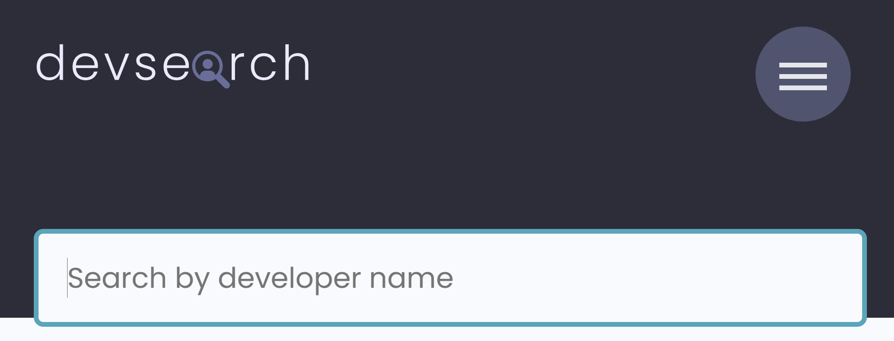
A PROJECT ON
DevSearch
A developer hunting platform
SYNTAX ERROR

Slide 3

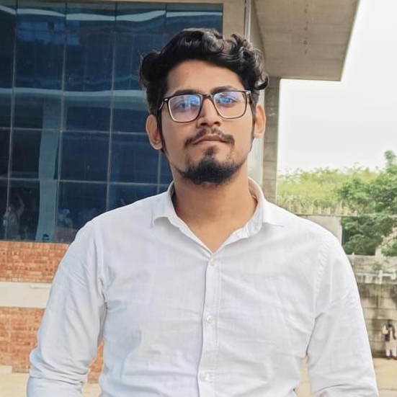
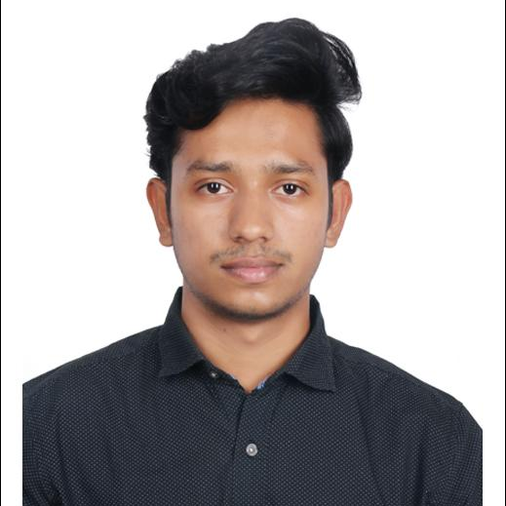
MEET THE TEAM
Md. Rayhan Kabir
ID:42230301147
Program: ECSE
Section: C
Joy Chandro Debnath
ID:42230301130
Program: ECSE
Section: C
MD Fahruzzaman
ID:42230301123
Program: ECSE
Section: C
SYNTAX ERROR

Slide 4

AGENDAS
Introduction on the project.
Objectives
Features
Tools & Technology
Flowchart
Outputs
Conclusion
Acknowledgement
SYNTAX ERROR

Slide 5
Introduction on the project.
SYNTAX ERROR
DevSearch is a web-based platform designed to connect developers with potential employers. It aims to streamline the hiring process for both parties by providing a centralized platform for talent discovery and job posting.

Slide 6
Objectives
SYNTAX ERROR
Connect Developers Worldwide: Create a space where developers from various backgrounds can interact.
Promote Collaboration: Enable teamwork by sharing projects, code snippets, and ideas.
Enhance Learning: Provide access to resources, tutorials, and discussions to support continuous learning.
Career Growth: Facilitate job opportunities and mentorship programs for developers.
Showcase Skills: Allow users to display their portfolios, repositories, and achievements.

Slide 7
Features
SYNTAX ERROR
User Registration & Authentication
Developer Profiles with Skill & Preference Filtering
Project Creation, Editing, and Deletion
Advanced Project Search with Multiple Filters
Messaging System between Users
Commenting System on Projects
Account Verification System
Password Reset Functionality
Basic User Management (Admin Dashboard)
User Profile Verification

Slide 8
Tools & Technology
SYNTAX ERROR
Backend: Django (Python)
Database: SQLite
Frontend: HTML, CSS (with potential integration of a CSS framework Bootstrap)
Frontend Templates: Based on Figma

Slide 9
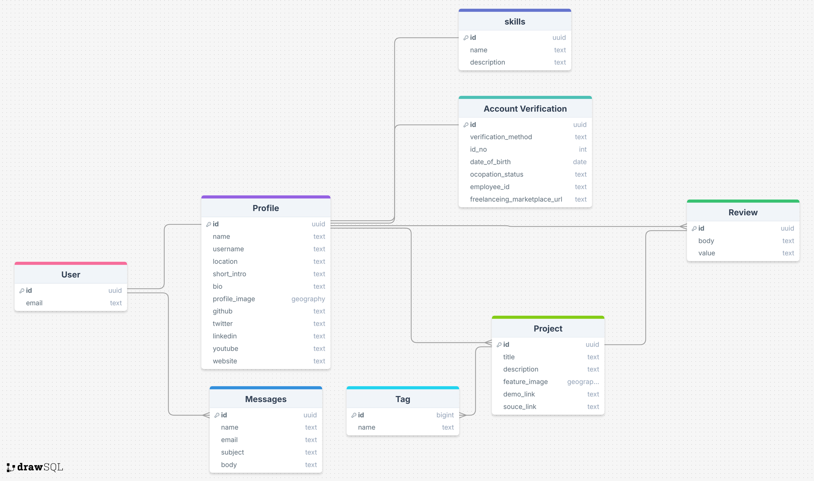
Flowchart
SYNTAX ERROR

Slide 10
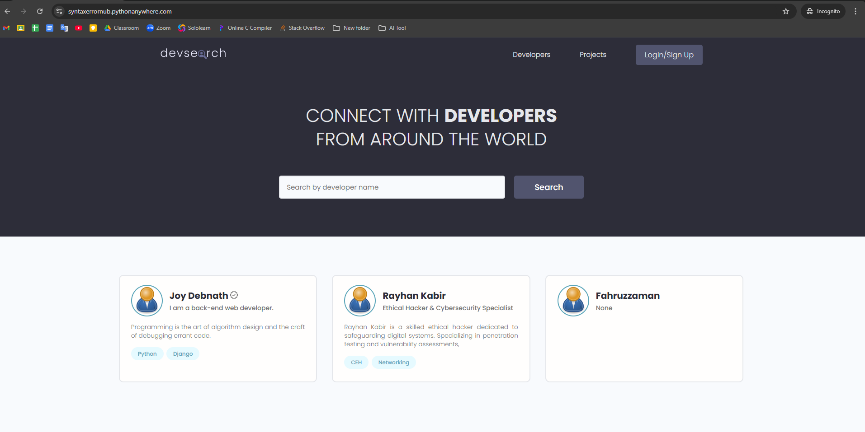
Outputs
SYNTAX ERROR

Slide 11
Conclusion
SYNTAX ERROR
DevSearch aims to bridge the gap between developers by providing a comprehensive platform for networking, learning, and growth. By integrating essential features with user-friendly tools, DevSearch has the potential to become the go-to platform for the global developer community.

Slide 12
Acknowledgement
SYNTAX ERROR
We would like to express our sincere gratitude to our teacher, Rumman Ahmed Prodhan Sir who gave us the golden opportunity to do this wonderful project,
which also helped us in doing a lot of Research and we came to know
about so many new things. we are really thankful.
Thank you so much, Sir.
Syntax Error.

Slide 13



SYNTAX ERROR
DO YOU HAVE ANY QUESTION ?
Feel Free To ASK!

Slide 14
Thank You Everyone!
SYNTAX ERROR
“Always smile and say Alhamdulillah!” - Rayhan Kabir

